Slide 1
Club Membership Information
About
The Automotive 30% Club is a network of MDs and CEOs from UK based automotive manufacturing, retailing and supplier companies. The network was founded in 2016 by Julia Muir, CEO of Gaia Innovation Ltd, with the purpose of encouraging inclusive leadership and achieving a better gender balance within the automotive industry, and with the aim of filling at least 30% of key leadership positions in the member organisations with diverse women by 2030 through a “30 by 30” strategy.
“
Our membership is growing at a steady pace. Our Partner Sponsor and Patron of the Club is The IMI, and our other Patrons are the leaders of Volkswagen Group UK ,Toyota GB Plc, Jardine Motors / Lithia Driveway, Arnold Clark ,Keyloop, Auto Trader UK, Cox Automotive, and LKQ Euro Car Parts. Silver members are the leaders of Kia, Bentley, TrustFord, Close Brothers Motor Finance, Motonovo Finance, Santander Consumer Finance, Solus Accident Repair, Scania, SOGO Mobility, V12 Finance, Vantage Motor Group, Stoneacre, Carwow, Enterprise Holdings, and Thatcham Research. Standard members include the leaders of Renault UK, Volvo Cars UK, Perrys, Vertu Motors, JCT600, Inchcape, Hendy Group, Renault Retail Group, Paragon Bank, Zenith, the NFDA, the IAAF and Dealer Auction Ltd.
30 by 30 Strategy
This seeks to achieve business transformation through people - understanding that diverse gender balanced teams lead to better business success. The strategy has six steps:
1. Know Your Data - be accountable for progress
2. Reach Out to New Talent Pools – find new sources of skills
3. Recalibrate for Inclusion – design for productivity not presenteeism
4. Welcome In The Women – recruit equitably
5. Pull Women Through the Pipeline – promote proportionately
6. Hold On to Your Investment – maintain the balance
The 30% target is to set a direction of travel to enable progress to be measured; something that is essential in such an objectives driven business. It is not a quota and we do not endorse positive discrimination. Members share an enthusiasm to improve the gender balance and diversity in the sector, in order to improve the image of the industry, serve the customer base better, enhance company performance, and make the workplace an equitable environment by removing unconscious bias and obstacles that prevent talented diverse women progressing up the career ladder.
We Collaborate to Accelerate the Change
Our Meetings and Events
We have closed circle digital meetings that provide a forum for members to candidly discuss key topics and share what has worked in their businesses. Such group meetings are quarterly and include the Retailer CEOs, the Aftermarket Leaders, the OEM People Directors, the 30 by 30 Leaders, and the Early Careers Group. We also hold three Inspiring Conversation digital events a year, and our annual conference takes place in London each May.

Slide 2
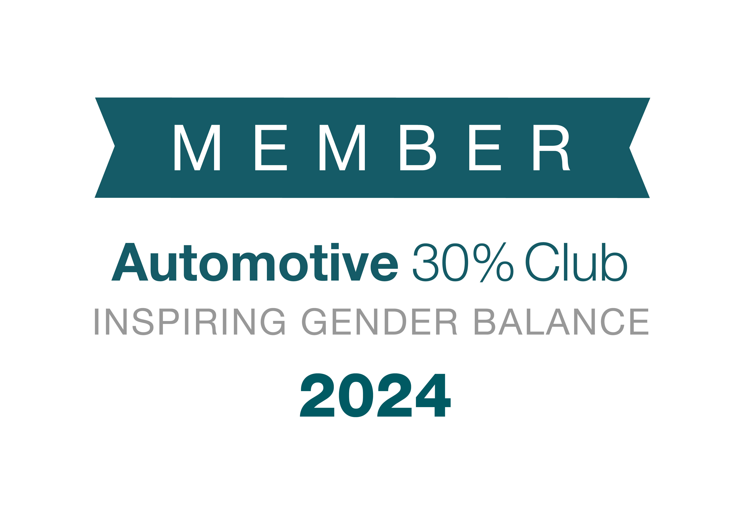
Standard Membership £1750+VAT Standard membership is for 12 months and is available to all MD/CEO members, new and current. Membership includes: A launch meeting video call workshop with Julia Muir to kickstart your 30 by 30 strategy and bring your leadership team on board. This will be tailored to your company needs and business content Invitation to participate in sector based CEO or closed roundtable discussions to learn and share solutions and inclusive leadership best practice with peers Invitation for your 30 by 30 leader to attend regular best practice sharing sessions Invitation for representative to attend regular Early Careers best practice sharing meetings 5 complimentary copies of Julia Muir’s book “Change the Game; the Leader’s Route Map to a Winning Gender-Balanced Business”, including the audiobook option Complimentary attendance at the annual Club conference, for the CEO / MD member and the ‘30 by 30’ strategy leader Use of the “Member of the Automotive 30% Club” logo on your stationery and website Advice on how to promote your company as an inclusive employer of choice for women | Silver Membership £3000 +VAT This 12 months membership is for members who would like to be ambassadors and advocates of the Automotive 30% Club and signal their strong support for the campaign. Membership includes: All the benefits of the standard membership, with the option of the workshop to be delivered in person at your premises 10 complimentary copies of Julia Muir’s book “Change the Game; the Leader’s Route Map to a Winning Gender-Balanced Business”, including the audiobook option Use of the “Silver Member of the Automotive 30% Club” logo on your stationery and website Member to be featured on the Silver Member page of the Club website, along with headshot and quote Article announcing your Silver Membership on social media, promoting your company as a strong supporter of the Club Two extra tickets to the annual conference Opportunity to participate in the annual conference as a guest speaker Invitation to take part in quarterly Silver Member best practice sharing sessions and meetings to discuss how to be advocates and ambassadors to help progress the campaign Patron/ Gold Membership is by invitation only

Slide 3
Next steps
After initial conversations with Julia Muir we require a signature from the CEO /MD member, on the pledge below to confirm commitment to joining our collaborative network. Following receipt of this we will send through an invoice to cover the costs of your annual membership fee.
After receipt of payment we will make a public announcement on LinkedIn to welcome you to our network, and notify all members by email, and your logo will appear on the appropriate member page on our website. It would be great if you would provide us with a quote and a headshot from the member to include. In addition, we kindly ask that should you also want to make a public announcement, that this is done in sync with ours.
As an ongoing campaign, we would like to support the great work you are doing within your organisation, in relation to our joint aim of achieving a better gender balance within the automotive sector, so please do send any relevant articles, stories and case studies that we could share amongst our network.
Member Pledge
I, the CEO / MD, understand the membership criteria of the club and agree to:
Pay the annual membership subscription
Nominate a ‘30 by 30’ strategy leader - typically the HR Director or Commercial Director (or both)
Implement a ‘30 by 30’ strategy within my organisation with a diverse female representation objective
Monitor the gender balance data in key roles across the organisation
Communicate membership of the club internally and amplify the announcement release communications upon joining, in conjunction with the Automotive 30% Club
Attend the annual conference, attend CEO / MD meetings and encourage the 30 by 30 leader to attend relevant best practice sharing sessions
If a Silver Member, attend Silver Member meetings to help share best practice, and be a vocal and visible ambassador and advocate for the club by participating in conferences, social media campaigns and encouraging other business leaders to join the club and aim for gender-balanced businesses.
If a Patron Gold Member, attend Patron meetings to help steer the direction of the Club, and participate in the annual conference and other events on rotational basis with other Patrons.
Signature: …………………………………………………………
Name: ……………………………………………………………… Date: ………………………………………..
Please return this signed page along with your quote for our release. Upon receipt, an invoice will be raised, and once payment has cleared, we will make our public announcement to welcome you to the club.

