Slide 1
Inspiring Automotive Women -
Who Inspires You?
LinkedIn Campaign July 1st – 5th
Kindly sponsored by

Slide 2
What Is the Criteria for an
Inspiring Automotive Woman?

Slide 3
An Inspiring Automotive Woman is:
Helping to promote the company as an employer of choice for women
Undertaking school / college / university outreach
Establishing a D&I or women's network
Mentoring or coaching female colleagues
Creating solutions and policies to help women to thrive in the workplace
Being a visible female automotive influencer / spokesperson in the media
Raising awareness of intersectionality and underrepresented female groups
Being an inspirational female role model
Inspiring you or her peers to create an inclusive culture
Driving change to ensure we serve female customers better
.

Slide 4
What Should the LinkedIn
Post Look Like ?

Slide 5
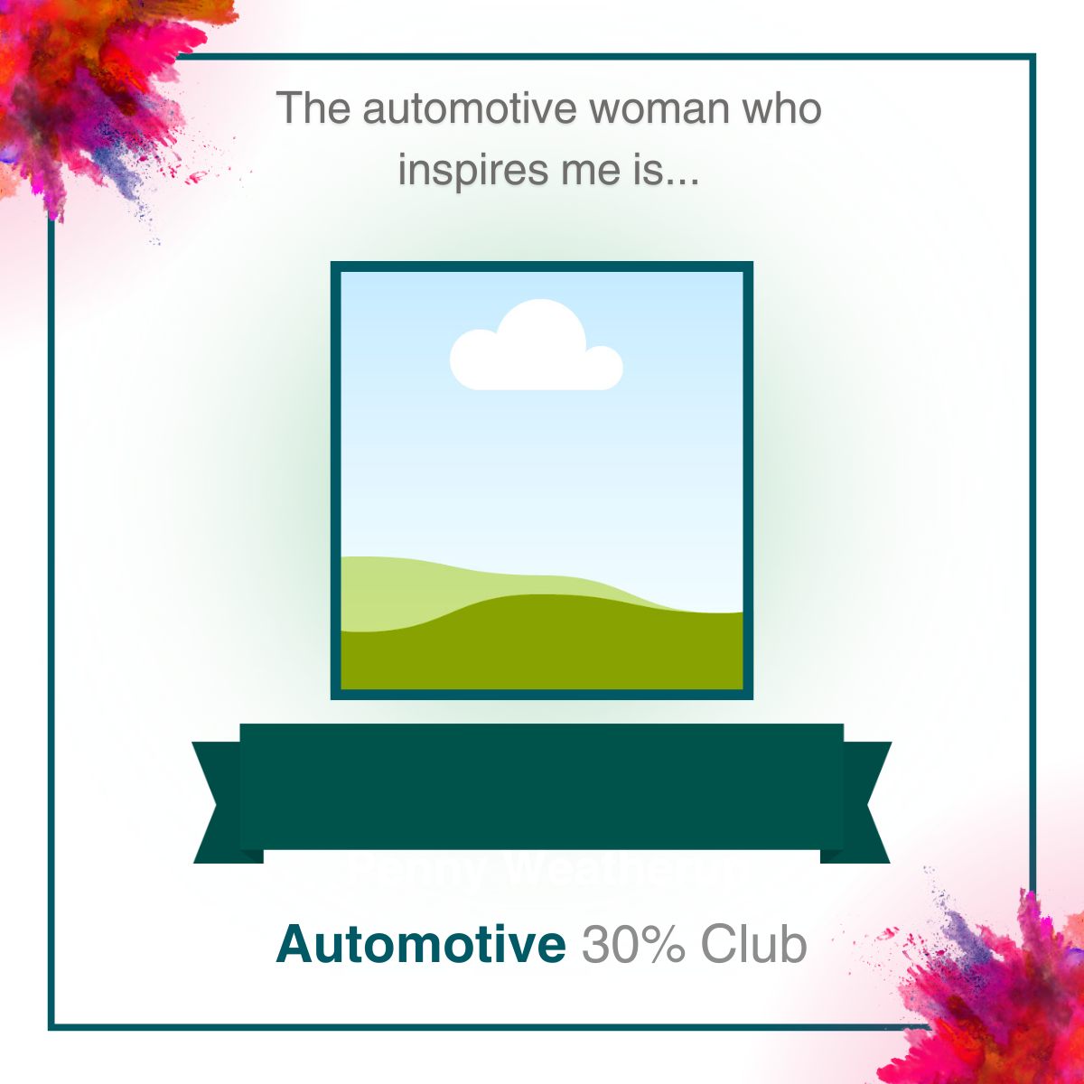
Use this template if you have permission to use a photo of your
Inspiring Automotive Woman

Slide 6
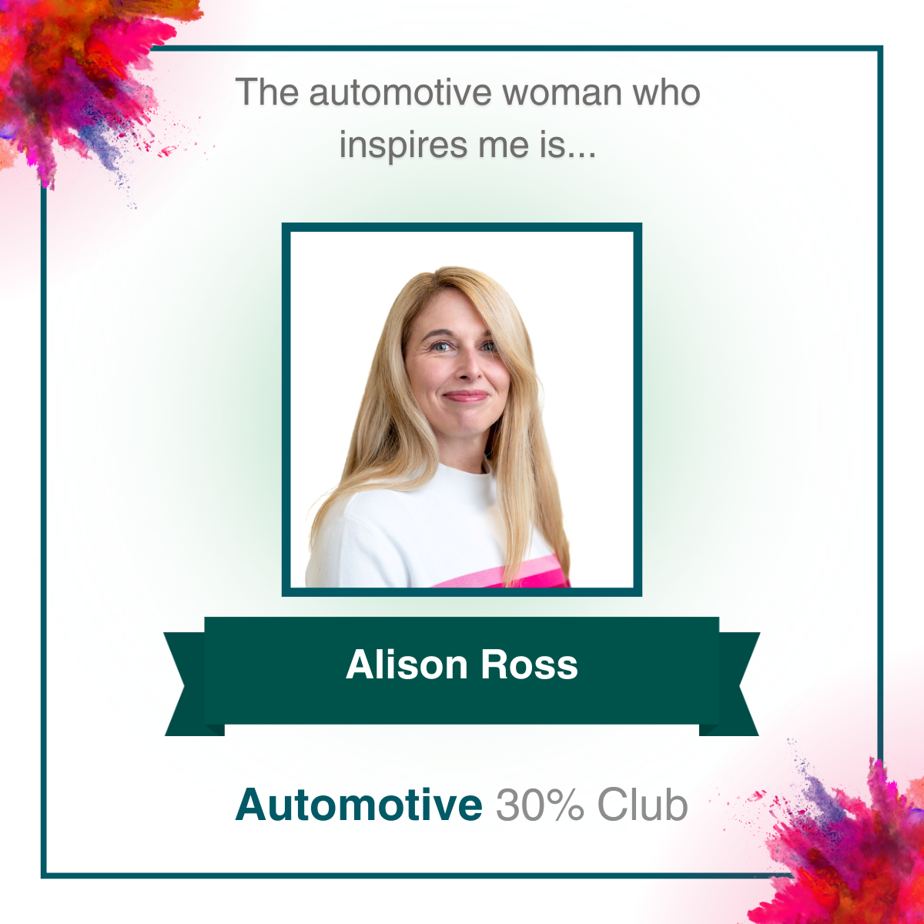
Here is an example, showing an
image of Alison Ross, our 2024 overall Inspiring Automotive Woman
of the Year

Slide 7
Use this template if you do not
have permission to use a photo of your Inspiring automotive Woman.
Insert her name via a text box across
the green ribbon.

Slide 8
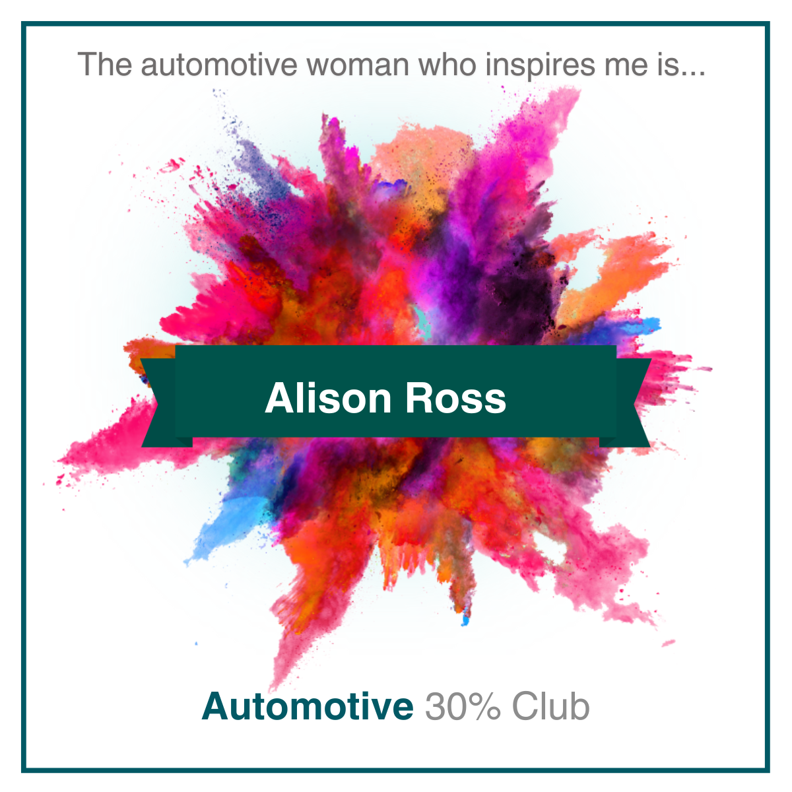
Here is an example, using the
name of Alison Ross.

Slide 9
The text of your LinkedIn post should start with:
“The automotive woman who inspires me is {NAME} because…..………………………………{insert reason}
The text of your LinkedIn post should end with:
“That is why {NAME} is an #InspiringAutomotiveWoman.
So, #WhoInspiresYou ?”

Slide 10
The Automotive Woman Who Inspires Me is Alison Ross. She commits her time, energy and drive to opening up the opportunity to work in the technology and automotive industries to people from all backgrounds. Ali goes above and beyond to champion diversity in the workplace and is an inspiring role model for women in our business and beyond.
She is dedicated to developing the North West’s tech and digital industry. Ali has spearheaded many initiatives to increase diversity and social mobility - from chairing Manchester Digital and Manchester Digital’s Employers' Forum to sponsoring the Digital Her and Tech apprenticeships initiatives. Through this work and mentoring many people she has inspired thousands to join our Industry. As if this isn't enough, Ali inspires me every day to be myself, to do more, to change things faster and to make our industry better for everyone in it and anyone who might want to join. Ali always says what she thinks, owns what she says, and cracks on, inspiring others to join her on the journey.
That is why Alison Ross is an #InspiringAutomotiveWoman
So, #WhoInspiresYou ?”

Slide 11
How To Make Your Own Post
1.Download the template you wish to use, and add the photo and / or name of the woman you are nominating.
2. Export your now personalised PPT slide as a png or jpeg image, so that LinkedIn recognises it as a photo.
3.On your LinkedIn page you will see at the top of your feed a place where it states “Start a post”.
4.Click on this statement and write what you want to say about your Inspiring Automotive Woman, and use the hashtags and opening and closing phrases
5.Remember to tag our @Automotive 30% Club showcase page
6.Click on the “photo” icon on the bottom left to upload your image
of your personalised slide

Slide 12
Who Can Create the LinkedIn Post?
You as an individual on your personal LinkedIn account.
The company marketing or social media team can ask colleagues to submit
their content for posting through the company LinkedIn account, crediting
the colleague with the nomination.
(Note however that a personal nomination from a colleague tends to have
a more positive impact than a corporate one)

Slide 13
When Should I Post the Nomination
On LinkedIn?
From 08.05 on Monday July 1st to 15.00 Friday July 5th
(NB: July 5th will be Election Results Day)

Slide 14
We will start the campaign with a post about Alison Ross at 08.00 on Monday July 1st, encouraging everyone to name a woman who inspires them so she could have the chance of being our 2025 winner
You can post any time from
08.05 on Monday July 1st to 15.00 on Friday July 5th
Note that the best times for your post are early morning, lunchtime and before 15.00, Monday to Thursday.
If you are naming more than one woman, please space them through the week rather than all on the same day
Remember to tag us and also your company so that others will see it
You can schedule your post in advance by clicking on the clock icon
on the bottom left of the post

Slide 15
How Will The Winners
Be Selected?

Slide 16
Every post that features the hashtags #InspiringAutomotiveWoman or #WhoInspiresYou and tags the Automotive 30% Club LinkedIn showcase page will be reacted to by our page, and added to a tracking list of nominations. If the woman receives multiple nominations, all will be included
Each nomination will be assessed based on how well the it meets the criteria for an Inspiring Automotive Woman
A shortlist of at least 20 women will be selected, and their nominators and companies will be approached to provide more detailed information
The 10 most Inspiring Automotive Women will be named as IAW Award winners of 2025 in January, and shortlisted for the IAW of the Year Award, in association with The IMI, and the overall winner will be selected by
The IMI Awards judges

Slide 17
How Will The Winners
Receive Their Awards?

Slide 18
The 10 Inspiring Automotive Women Award winners of 2025 will be invited to the IMI Awards Dinner in March to receive their awards at a private reception.
Each winner will receive a complimentary ticket to the dinner, and their companies will be encouraged to buy further tickets to the dinner for colleagues and friends to see them receive their award at the private reception
The 10 winners will be revealed at the dinner as the shortlist for the Automotive 30% Club IAW of the Year Award in association with The IMI
Julia Muir will present the overall winner with her award during the main IMI Awards ceremony

Slide 19
Let’s hit over 500
nominations this year!
With thanks to

